Slide 1
LIQUID CRYSTALS
Introduction
Classification
Applications

Slide 2
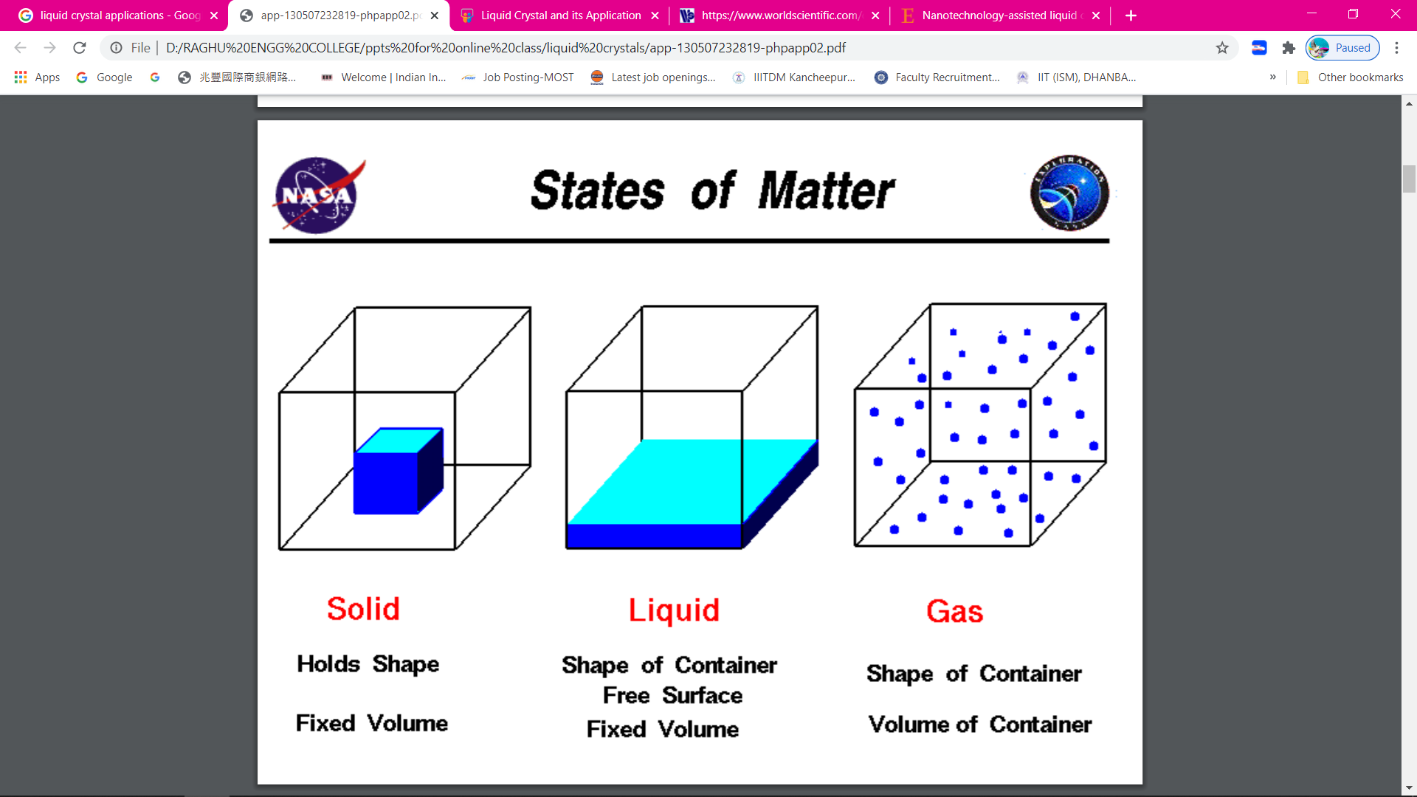

Slide 3
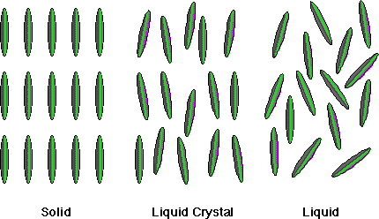
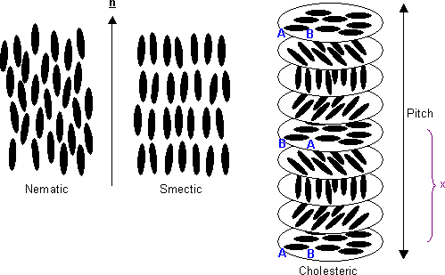
Fourth Sate of Matter

Slide 4
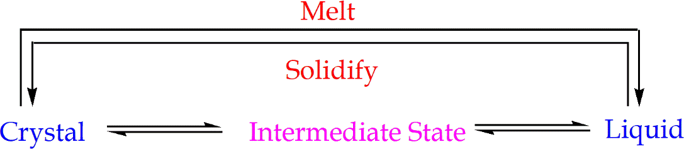
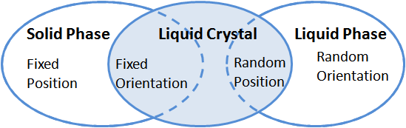
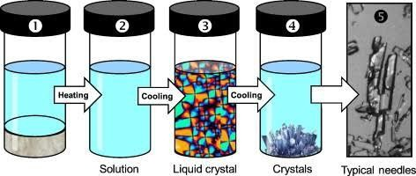
Introduction
A liquid crystal is an intermediate state between the crystalline solid and the ordinary liquid phase
Condense fluid phases with spontaneous anisotropy
*Anisotropy: Change in Physical Properties with direction; One of the property of Crystal Lattice

Slide 5
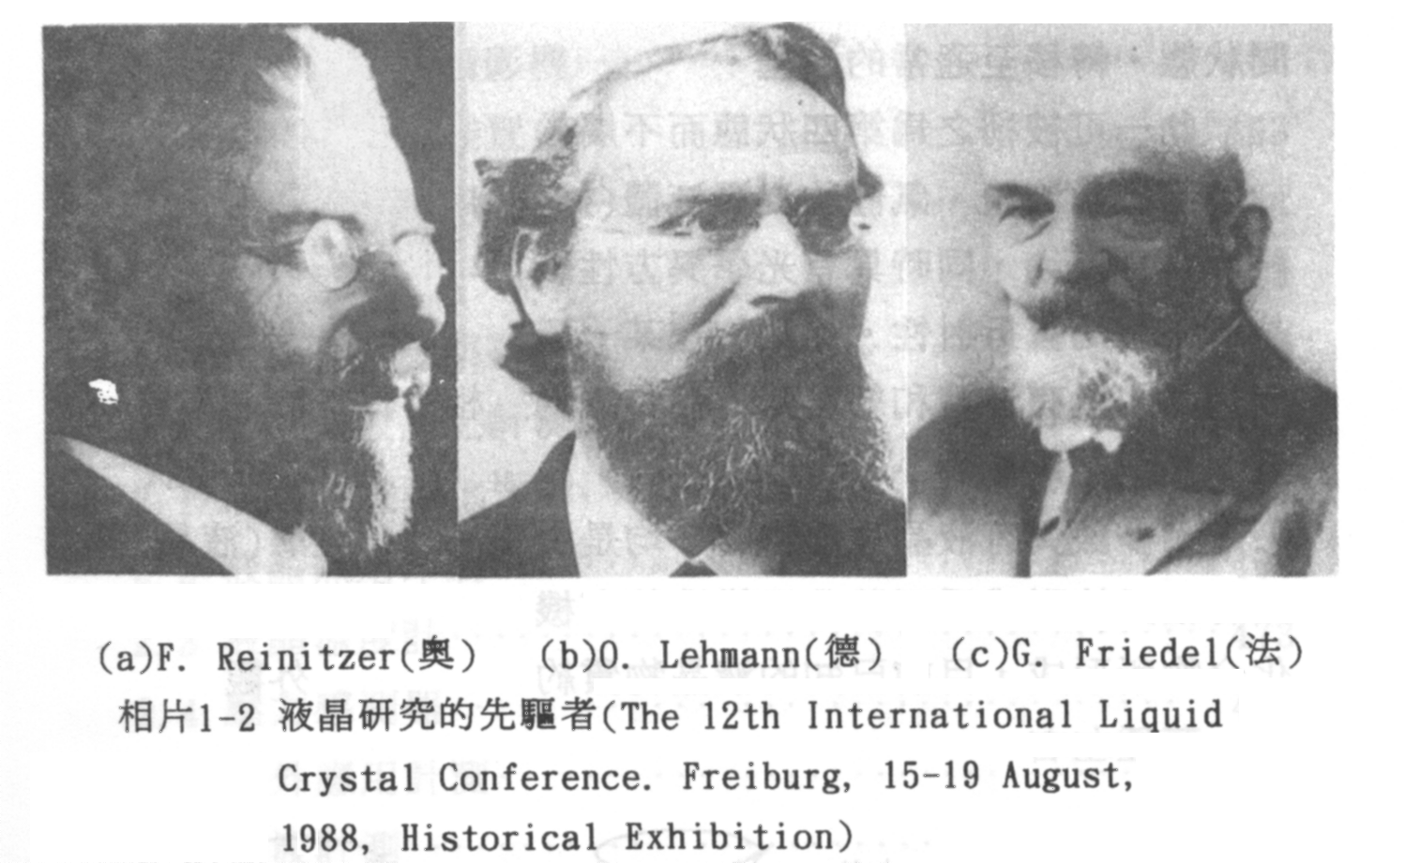
Liquid Crystals, 1805-1922.
Before discovery of LC, Lehmann designed a microscope that could be used to monitor phase transition process.

Slide 6
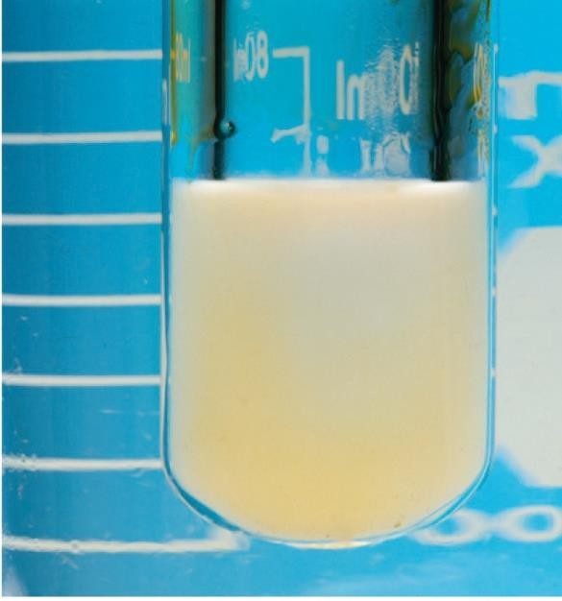
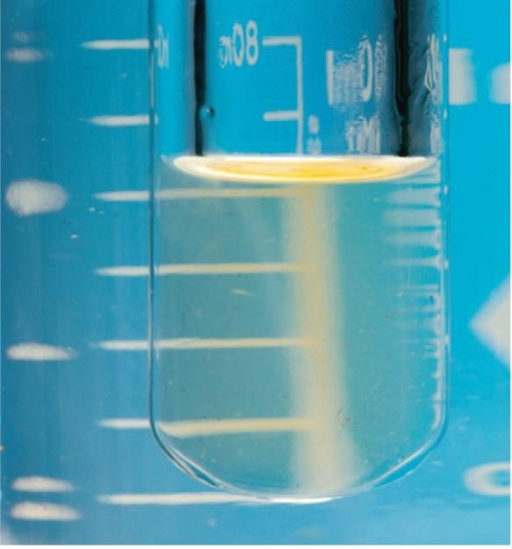

Discovery of Liquid Crystal (LC)
Discovered by Frederick Reinitzer in 1888
Cholesteryl Benzoate shows two melting points
One at 145ºC into a cloudy fluid
Another at 179ºC to form clear liquid
Viscous Milky Liquid
Clear Liquid
H
O
H
H
O
Cholesteryl Benzoate
Solid T < 145ºC 145ºC < T < 179ºC Above 179ºC
*Viscous liquid form of Cholesteryl Benzoate is its liquid crystal form

Slide 7
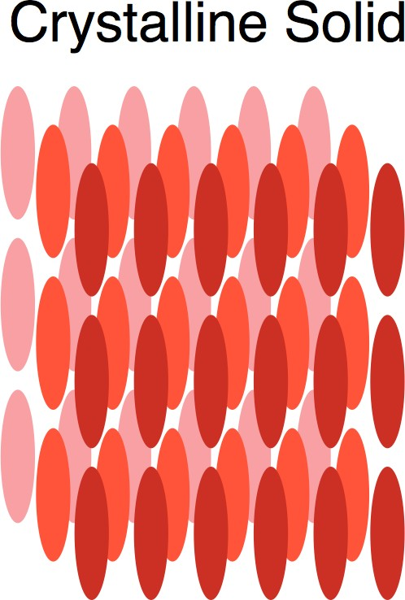
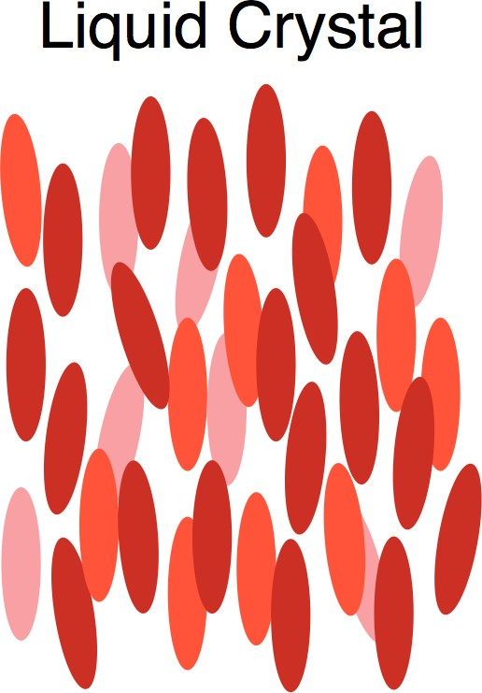

Like crystalline solids, LCs are anisotropic in nature
With change in temperature, the orientation of molecules changes
Heating
Heating
⇌
Cooling
⇌
Cooling
Anisotropic
Isotropic

Slide 8
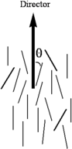
Degree of Orders in LC
Positional order
Orientational Order
Bond orientational order
Director: It is the average direction of all molecules present in the LC

Slide 9
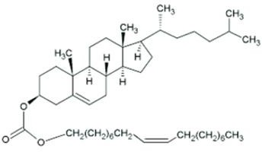
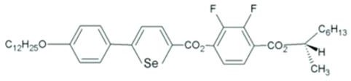
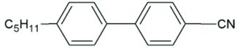
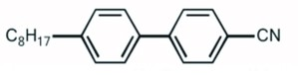
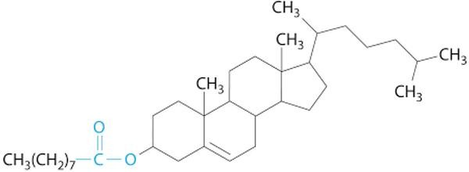
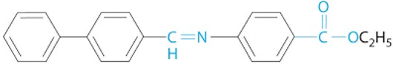
Substances that exhibit the properties of LC consist of long, rigid rod- or disk-shaped molecules that
are easily polarizable
Molecules with polar group that exhibit dipole-dipole interaction or dipole induced interactions, hydrogen binding are capable of forming LC
Examples
4-cyano-4-pentylbiphenyl (Nematic)
4-cyano-4-Octylbiphenyl (Nematic)
Cholesterol acetate (cholesteric)

Slide 10
Classification of Liquid Crystals
Thermotropic Liquid Crystal
Phase forms as a function of temperature
Lyotropic Liquid Crystal
Phase forms as a function of concentration and temperature
Metallotropic Liquid Crystals
Phase forms as a function of temperature, concentration, organic and inorganic composition ration changes

Slide 11
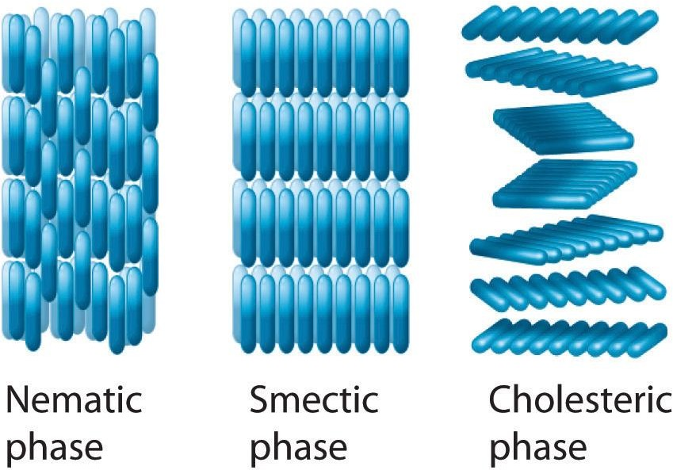
1. Thermotropic Liquid Crystal
Most extensively used LC
The phase changes with change in temperature
Based on the degree of alignment, thermotropic LC can be sub divided into three following categories
Nematic phase
Cholesteric phase
Smectic phase

Slide 12
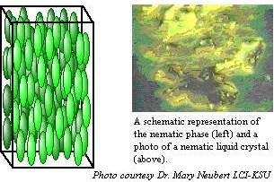
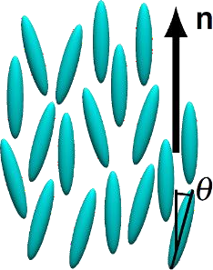
Nematic Phase
Molecules maintain parallel or nearly parallel arrangement to each other along the director
All the molecules are not unidirectional
Molecules have orientation but no long range positional order
Structure of Nematic phase can be altered by using external
electric and magnetic field
Most common LC phase

Slide 13
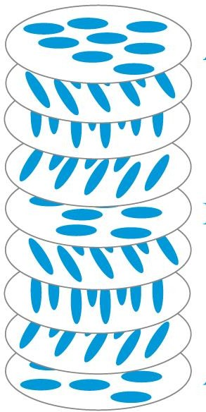
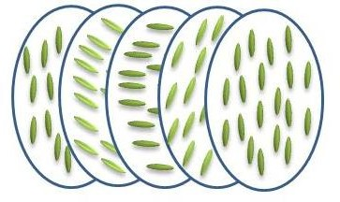
Cholesteryl phase or Chiral Nematic phase
This phase exhibits chirality
First observed for cholesterol derivatives
Only chiral molecules can give rise to this phase
The director is helical in nature
Pitch: The distance over which the director makes one complete turn
Pitch is affected by: Temperature, pressure, electric and magnetic field

Slide 14
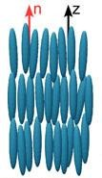
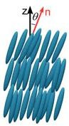
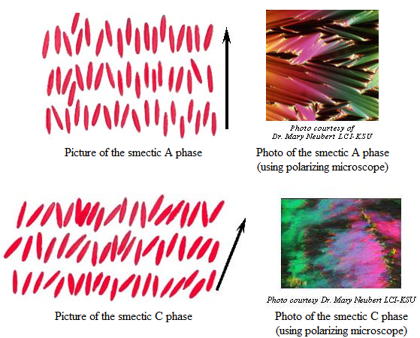
Smectic Phase:
Increasing temperature, solid crystal first converts to Nematic phase
All molecules are unidirectional
No correlation of the molecular position from one layer to the next
Consequently, well ordered layers can slide over one another in a manner similar to soap
Smectic A
Smectic C
Smectic A phase: Molecules are oriented along the director
Types
Smectic C phase: Molecules are tilted away from the director

Slide 15
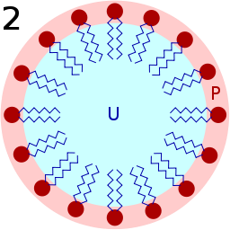
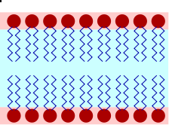
2. Lyotropic Liquid Crystal
Hydrophilic Head
Lyotropic LCs have two component
1. Hydrophilic Polar Head
Hydrophobic tail
2. Hydrophobic Non-polar Tail
Lyotropic phase shows LC properties only at certain concentrations
Extra solvent phase is required to provide fluidity to the system
Phase of LC changes with change in concentration and solvent
Soaps, detergents, surfectants are good examples of Lyotropic LC
^{N}Br⁻
n

Slide 16
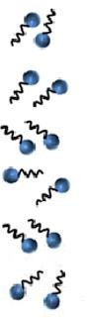
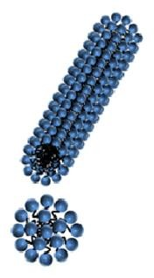
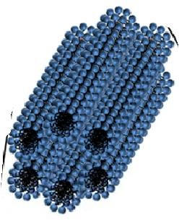
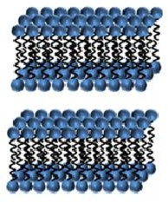
Change in Phase with Change in Concentration
Low Concentration
Slightly higher Concentration
Higher Concentration
More Higher Concentration
Free
Molecules
Micelle Formation
Hexagonal
Columnar Phase
Lamellar Phase
With increase in Concentration, phases are changing

Slide 17
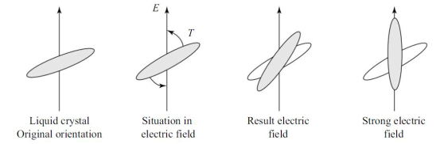
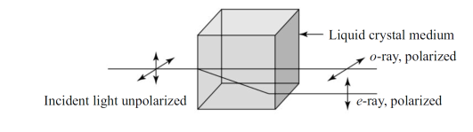
Properties:
Liquid crystals have unique physical and optical properties that make them useful in various applications. Here are some of the key properties of liquid crystals:
Anisotropy: Liquid crystals exhibit anisotropic properties, meaning they have different physical and optical properties in different directions. This anisotropy is due to the molecular orientation of the liquid crystal molecules.
Birefringence: Liquid crystals have birefringent properties, meaning they can split a single light beam into two beams with different polarizations. This property is used in optical applications, including polarizers and liquid crystal displays (LCDs).

Slide 18
Viscosity: Liquid crystals have a high viscosity, which means they flow slowly like a liquid but have some properties of a solid, such as resistance to deformation.
Optical Activity: Chiral liquid crystals can exhibit optical activity, which means they rotate the plane of polarized light as it passes through the material. This property is used in applications such as cholesteric liquid crystal displays.
Electric Field Response: Some types of liquid crystals, such as ferroelectric and twisted nematic liquid crystals, exhibit an electric field response, meaning they can be switched between different orientations by applying an electric field.
Temperature Sensitivity: Liquid crystals can exhibit temperature sensitivity, with their physical and optical properties changing as the temperature changes. This property is used in applications such as thermometers and thermostats.
Solvent Sensitivity: Some liquid crystals are sensitive to the surrounding solvent,

Slide 19
Applications of Liquid Crystals
Liquid Crystal Displays
Liquid Crystal Thermometers
Optical Imaging

Slide 20
Application: Liquid Crystal Display (LCD)
First synthesized LCD for commercial purpose is a chemically stable substances,
Cyanobiphenyls; Synthesized by George Gray in 1973
Because of two unique characteristics, LCs are used in LCD
Can rotate plane polarize light due to the unique direction of molecules
Change orientation in presence of applied Electric Field
Nematic LCs are mostly used in LCD

Slide 21
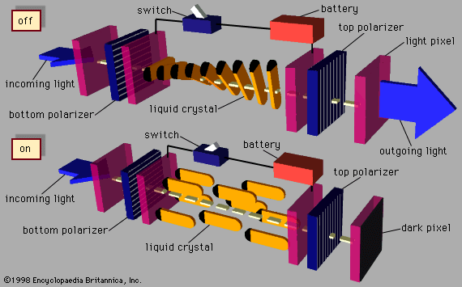

Slide 22
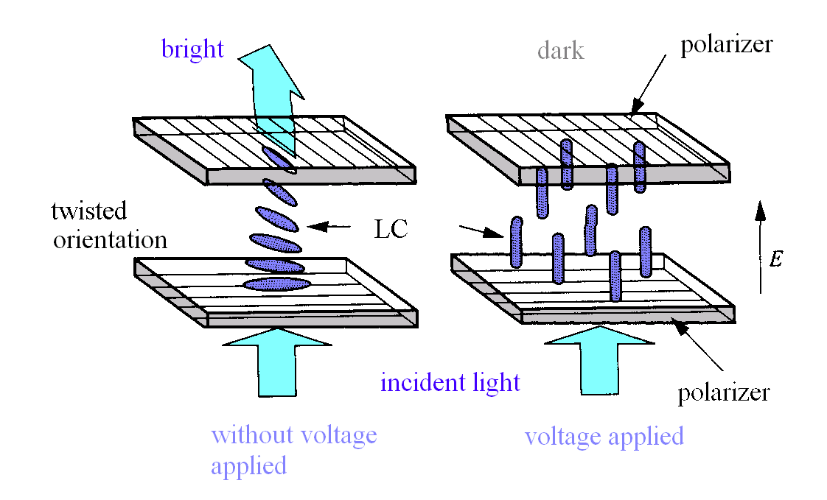
Twisted Nematic (TN) Device 1971 by Schadt

Slide 23
Advantages Of LCD
Brightness: Produces very bright images due to high peak intensity. Very suitable for environments that are brightly lit.
Emissions: Produce considerably lower electric, magnetic and
electromagnetic fields than CRTs.
Power Consumption:Energy efficient. Consume less than 1/3 the power of a comparable CRT. Consume less electricity than a CRT and produce little heat.
Physical Aspects:Take up about 40% less desk space. LCDs are thin and compact.
Screen Shape :Completely flat screen.
Sharpness: At the native resolution, the image is perfectly sharp. Adjustments are required at all other resolutions which can result in measurable degradation to the image.

Slide 24
Limitations :
There are some limitations in using liquid crystals. Unfortunately, liquid crystals are very difficult to work with and require highly specialized printing and handling techniques. Liquid crystals are also more expensive. They are adversely effected by high temperatures, ultra violet light, and strong solvents or chemicals.

Slide 25
Organic Light Emitting Diodes (OLEDs)
Organic light emitting diodes (devices) or OLEDs are monolithic, solid-state devices that typically consist of a series of organic thin films sandwiched between two thin-film conductive electrodes.
When electricity is applied to an OLED, under the influence of an electrical field, charge carriers (holes and electrons) migrate from the electrodes into the organic thin films until they recombine in the emissive zone forming excitons.
Once formed, these excitons, or excited states, relax to a lower energy level by giving off light (electroluminescence) and/or unwanted heat.

Slide 26
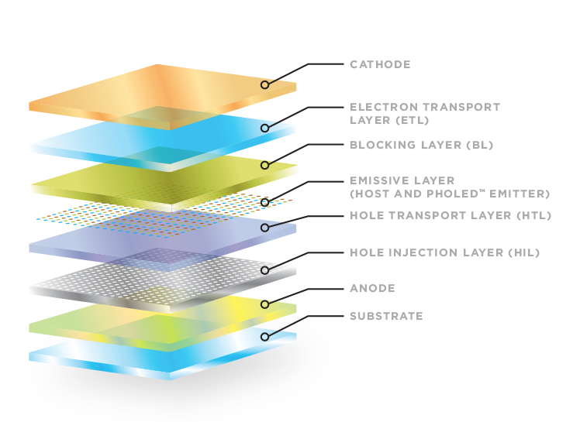
The basic OLED cell structure consists of a stack of thin organic layers sandwiched between a conducting anode and a conducting cathode. Breakdown of an OLED structure:
Substrate (can be plastic, glass, or metal foil) – Foundation of the OLED
Anode (may or may not be transparent depending on the type of OLED) – Positively charged to injects holes into the organic layers that make up the OLED device (ITO)
Hole Injection Layer (HIL) – Deposited on top of the anode this layer receives holes from the anode and injects them deeper into the device poly(3-hexylthiophene) P3HT
Hole Transport Layer (HTL) – This layer supports the transport of holes across it so they can reach the emissive layer
TPD [N,N′-Bis(3-methylphenyl)-N,N′-diphenylbenzidine]
NPB [1,4-bis(1-naphthylphenylamino)biphenyl]
Emissive Layer – The heart of the device and where light is made, the emissive layer consists of a color defining emitter doped into a host. This is the layer where the electrical energy is directly converted into light. Polyfluorene, Tris[2-phenylpyridine]iridium
Blocking layer (BL) – Commonly used to improve OLED technology by confining electrons (charge carriers) to the emissive layer
Electron Transport Layer (ETL) – Supports the transport of electrons across it so they can reach the emissive layer.
PBD = 2-(4-biphenyl)-5-(4-t-butylphenyl)-1,3,4-oxadiazole
Alq₃ = tris(8-hydroxyquinoline) aluminium
Cathode (may or may not be transparent depending on the type of OLED) – Negatively charged to inject electrons into the organic layers that make up the OLED device (ITO).

Slide 27
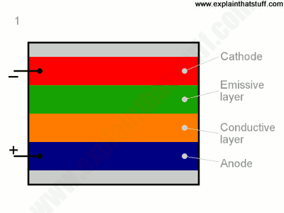
To make an OLED light up, we simply attach a voltage (potential difference) across the anode and cathode.
As the electricity starts to flow, the cathode receives electrons from the power source and the anode loses them (or it "receives holes," if you prefer to look at it that way).
Now we have a situation where the added electrons are making the emissive layer negatively charged (similar to the n-type layer in a junction diode), while the conductive layer is becoming positively charged (similar to p-type material).
Positive holes are much more mobile than negative electrons so they jump across the boundary from the conductive layer to the emissive layer. When a hole (a lack of electron) meets an electron, the two things cancel out and release a brief burst of energy in the form of a particle of light—a photon, in other words. This process is called recombination, and because it's happening many times a second the OLED produces continuous light for as long as the current keeps flowing.

Slide 28
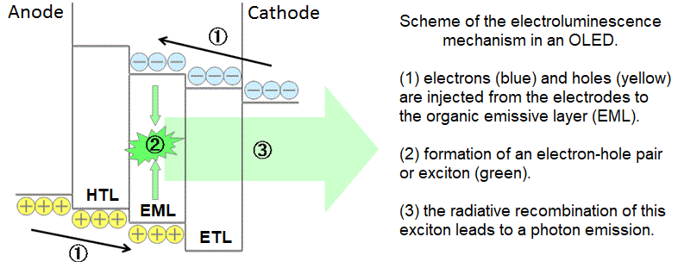

Slide 29
Properties:
Organic light-emitting diodes (OLEDs) have a number of properties that make them attractive for a variety of applications, including displays and lighting. Here are some key properties of OLEDs:
High contrast: OLEDs have a very high contrast ratio resulting in excellent image quality and clarity.
Wide viewing angles: OLEDs can be viewed from almost any angle without significant color distortion or loss of contrast, making them ideal for large displays and signs.
Flexible and thin: OLEDs can be made on thin and flexible substrates, allowing for new design possibilities and form factors.
Low power consumption: OLEDs consume less power than other display technologies, resulting in longer battery life for portable devices and lower electricity usage for lighting applications.
Fast response time: OLEDs have a very fast response time, meaning that they can display rapidly changing images without blurring or ghosting.
High color accuracy: OLEDs are capable of producing very accurate colors, making them ideal for applications such as photo and video editing, medical imaging, and color-critical industrial applications.
Scalable: OLEDs can be fabricated using a variety of techniques and can be scaled to large areas, making them suitable for use in large displays and lighting applications.

Slide 30
Application of OLEDs:
Organic light emitting diodes (OLEDs) are a type of display technology that is becoming increasingly popular in various applications. Here are some of the main areas where OLEDs are being used:
Display panels: OLED displays are used in various devices, such as smartphones, TVs, and computer monitors. These displays offer high contrast, vibrant colors, and excellent viewing angles.
Lighting: OLEDs are also being used as a lighting source in both commercial and residential settings. OLED lighting panels are thin, lightweight, and highly energy-efficient.
Automotive: OLEDs are used in the automotive industry for both interior and exterior lighting. They provide an innovative and modern look to cars and offer better visibility and safety.
Wearable technology: OLEDs are used in wearable devices such as smartwatches and fitness trackers. They offer brighter and more energy-efficient displays, making them ideal for small devices with limited battery life.
Medical devices: OLEDs are also used in medical devices, such as pulse oximeters and blood glucose monitors. They offer high brightness and low power consumption, making them ideal for portable devices.

Slide 31
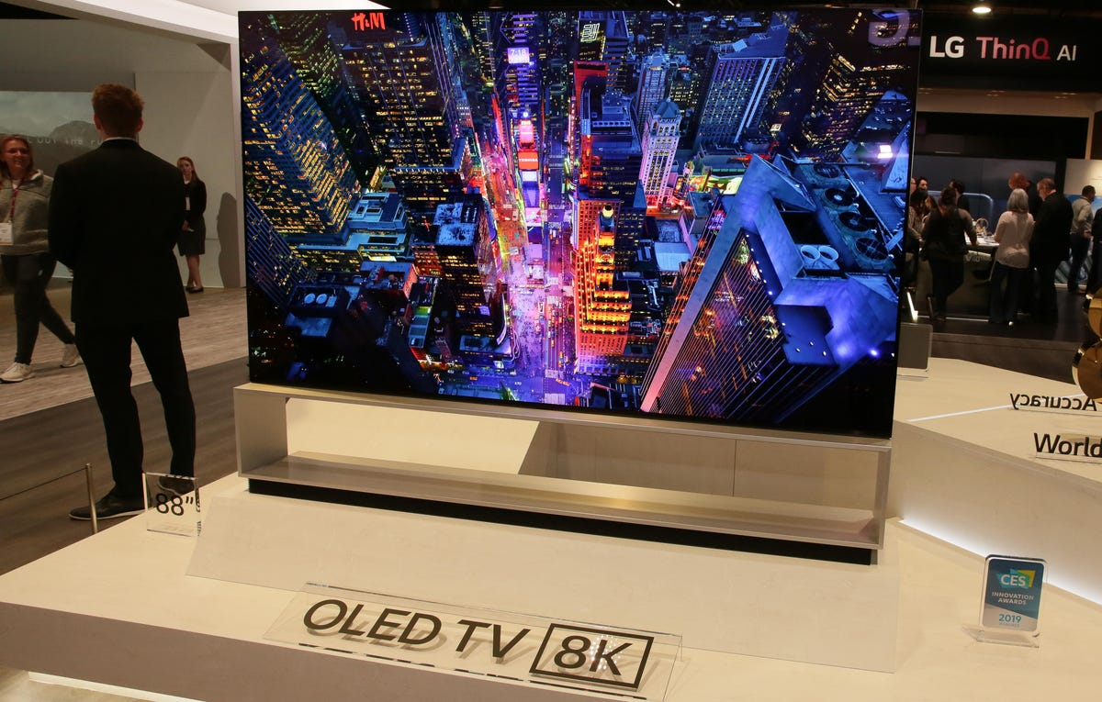
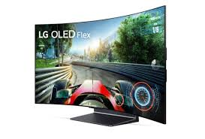

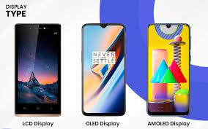

Slide 32
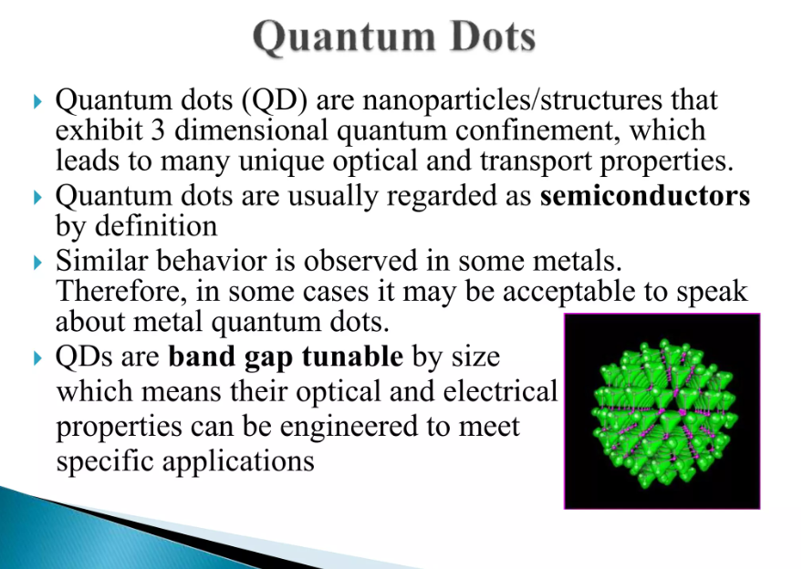

Slide 33
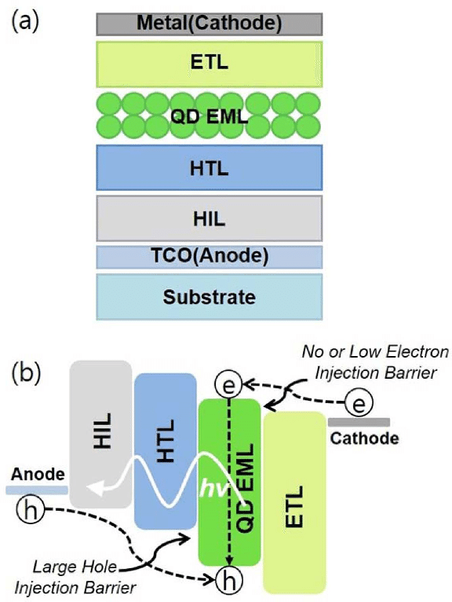
QLED
The mainstream commercialization of colloidal quantum dots (QDs) for light-emitting applications has begun: Sony televisions emitting QD-enhanced colors are now on sale. The bright and uniquely size-tunable colors of solution processable semiconducting QDs highlight the potential of electroluminescent QD light-emitting devices (QLEDs) for use in energy efficient, high-color-quality thin-film display and solid-state lighting applications.
Working principle of QLED
There are five typical layers for a QLED structure:
Electron transport layer (ETL)—for electron injection from the cathode and transportation of the electron.
Electron injection layer (EIL)—for electron injection from the cathode electrode.
Hole transport layer (HTL)—for hole transportation from HIL to EML.
Hole injection layer (HIL)—for hole injection from the anode electrode.
Emission layer (EML)—electron/hole transportation and their recombination to form an exciton; this is the QD layer in QLED.

Slide 34
Properties:
Quantum light emitting diodes (QLEDs) have a number of unique properties that make them attractive for various applications. Some of the main properties of QLEDs include:
High color purity: QLEDs can produce pure and vibrant colors because quantum dots can be precisely tuned to emit light at very specific wavelengths. This high color purity makes QLEDs attractive for use in displays and lighting applications.
High brightness: Quantum dots are very efficient light emitters, which means that QLEDs can produce high brightness with low power consumption. This makes QLEDs ideal for use in high-performance displays and lighting systems.
Narrow emission spectra: Quantum dots have a narrow emission spectra, which means they can produce light at a very specific wavelength. This can be useful for applications such as fluorescence microscopy, where precise control of the emitted light is important.
High color tunability: The color of QLEDs can be easily tuned by changing the size and composition of the quantum dots used. This allows for a wide range of colors to be produced, making QLEDs highly versatile.
Long lifetimes: QLEDs can have long lifetimes, with some devices showing little to no degradation in performance over thousands of hours of operation. This can make them attractive for use in applications where long-term reliability is important.

Slide 35
Application of QLEDs:
QLEDs offer several advantages over traditional LEDs, including higher efficiency, better color purity, and the ability to emit light at specific wavelengths. Here are some of the potential applications of QLEDs:
Display technology: QLEDs have the potential to revolutionize display technology by providing brighter, more vibrant colors and higher resolution than current LCD or OLED displays. Samsung has already introduced QLED displays in their high-end TVs.
Lighting: QLEDs can be used to create highly efficient lighting solutions that offer superior color rendering compared to traditional LEDs. They can also be used to create smart lighting systems that can be controlled remotely.
Medical imaging: QLEDs can be used in medical imaging applications such as fluorescence imaging, where they can be used to tag specific cells or molecules and emit light when activated by a specific wavelength of light.
Sensing: QLEDs can be used as sensors for various applications such as temperature, pressure, and chemical detection. The sensitivity and selectivity of QLED-based sensors can be tuned by changing the size, shape, and composition of the QDs.
Photovoltaics: QLEDs can also be used in photovoltaic cells, where they can be used to harvest light and convert it into electricity. QLED-based solar cells have the potential to be more efficient and less expensive than traditional silicon-based solar cells.

Slide 36
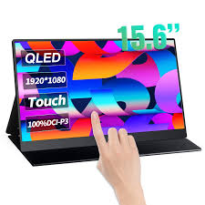
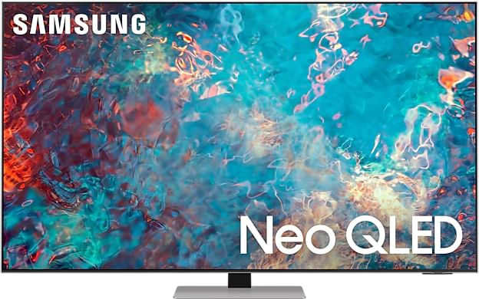


Slide 37
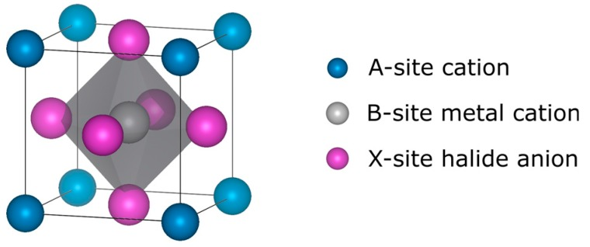
Perovskite materials
Perovskite materials belong to a fascinating class of compounds with a crystal structure that mirrors the mineral perovskite (CaTiO₃) or in the general formula of ABX3 (named after Russian mineralogist Lev Perovski). This structure comprises a cubic arrangement of atoms or ions, with a central ion surrounded by an octahedron of other ions.
Inorganic Perovskites: ABX3
Hybrid Organic-Inorganic Perovskites:
methylammonium lead iodide
Double Perovskites: A2BB'O6.
Doped Perovskites:
introducing impurities or substituting compounds
Layered Perovskites:
stacking layers of perovskite-like units
Metal-Organic Framework (MOF) Perovskites:

Slide 38
Properties
Optical Properties:
High Absorption: Perovskites exhibit excellent light absorption across a wide range of wavelengths, including visible and near-infrared light, making them efficient for photovoltaic applications like solar cells.
Tunable Bandgap: Their bandgap can be adjusted by altering their composition, allowing customization for optimal light absorption and energy conversion in solar cells and other optoelectronic devices.
Electronic Properties:
High Carrier Mobility: Perovskites demonstrate high carrier mobility, allowing efficient charge transport within the material, crucial for high-performance electronic devices.
Low Non-radiative Recombination: This property helps in minimizing energy losses, contributing to high-efficiency devices.

Slide 39
3. Structural Versatility:
Diverse Composition: Perovskites can incorporate various metal cations, halide anions, and organic molecules, allowing for a wide range of compositions and properties.
Structural Flexibility: The perovskite structure can accommodate different elements and substitutions, offering versatility in tailoring materials for specific applications.
4. Solution Processability:
Low-Cost Fabrication: Perovskite materials can be processed using low-temperature and solution-based methods like spin-coating, inkjet printing, or evaporation, potentially reducing manufacturing costs compared to traditional semiconductors.
5. Efficiency and Performance:
Rapid Progress in Efficiency: Perovskite solar cells have seen a swift increase in power conversion efficiency (PCE) over a short time, rivaling and even surpassing some conventional solar cell technologies.

Slide 40
Perovskite materials have emerged as promising candidates in the field of optoelectronics due to their exceptional properties, enabling various applications in this domain.
Solar Cells:
High absorption coefficients across a broad spectrum of light wavelengths, including visible and near-infrared, make them efficient light absorbers.
Rapid progress in power conversion efficiency (PCE), reaching levels competitive with traditional silicon-based solar cells.
Potential for low-cost manufacturing using solution-based processing methods, such as spin-coating or printing, enabling cost-effective large-scale production.
Light-Emitting Diodes (LEDs):
Perovskite materials exhibit efficient light emission and tunable bandgaps, making them promising for LEDs and displays.
Their ability to emit light across various wavelengths, including pure and saturated colors, is advantageous for display technologies.

Slide 41
3. Lasers:
Perovskites have shown potential in laser applications due to their excellent optical properties, such as high photoluminescence quantum yield and tunable emission spectra.
Their ability to generate coherent light across different wavelengths makes them suitable for use in lasers.
4. Photodetectors:
Perovskite-based photodetectors offer high sensitivity to light and fast response times.
Their excellent charge carrier transport properties result in high-performance photodetectors suitable for various applications, including imaging and sensing.
5. Optical sensors: Perovskites have been used in optical sensors due to their high sensitivity to light, good stability, and low cost. Perovskite-based sensors have been developed for various applications, such as chemical sensing, biosensing, and environmental monitoring.

Slide 42
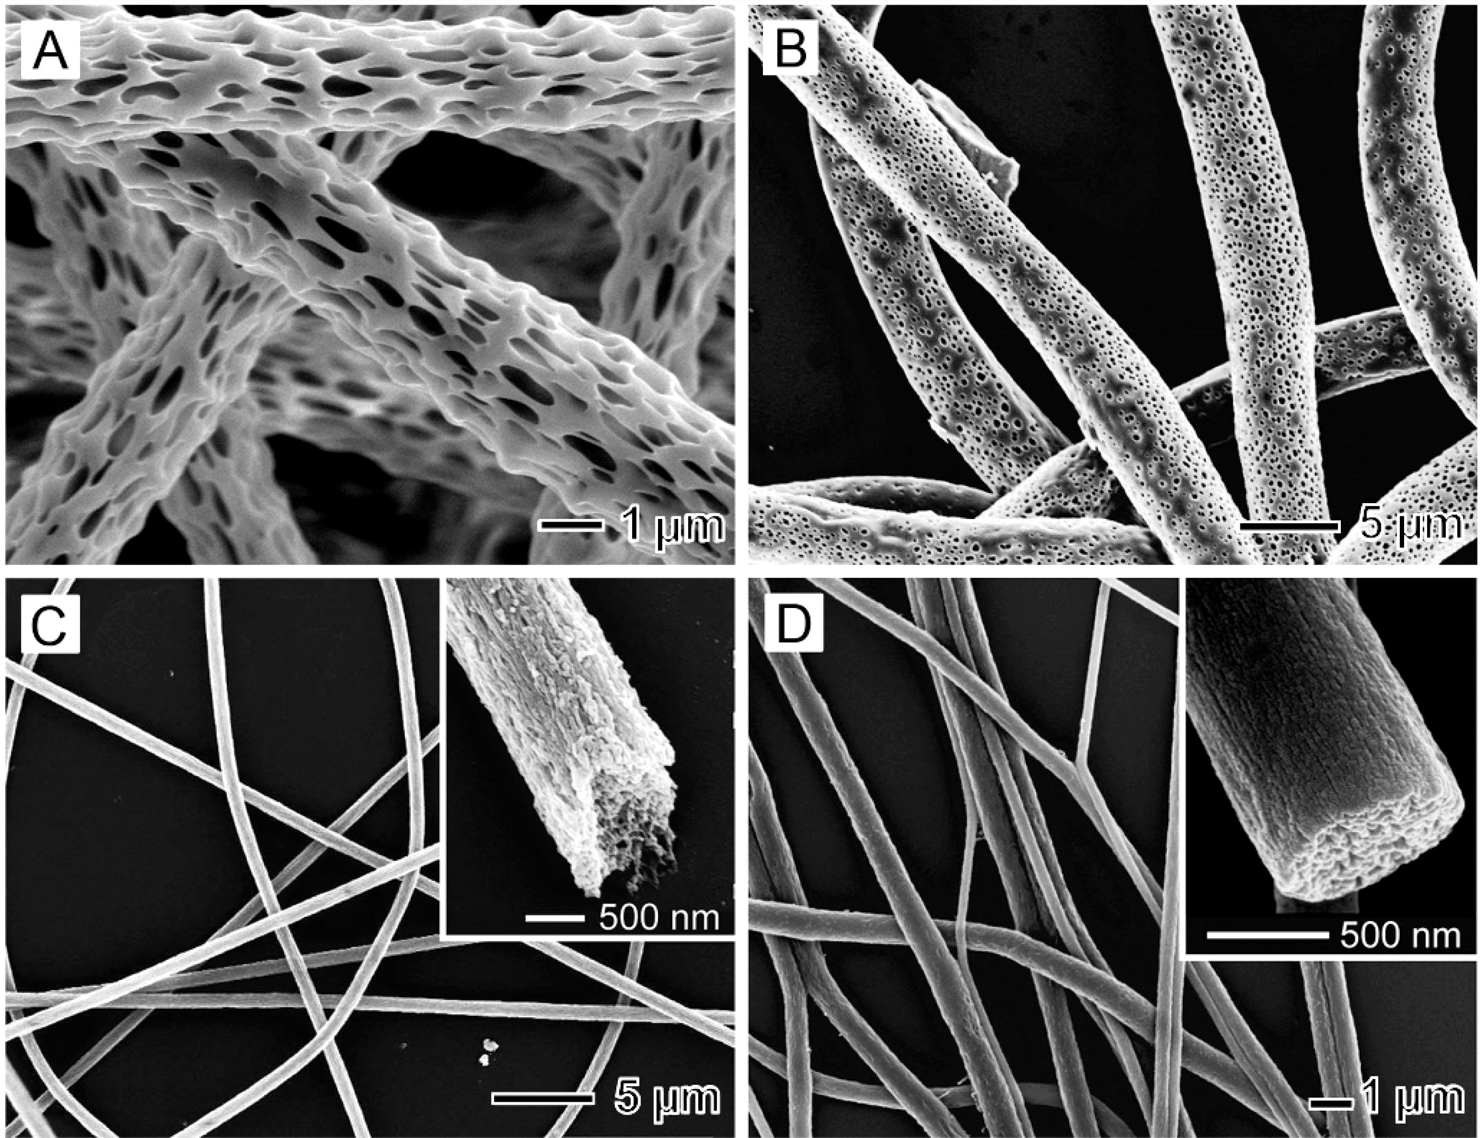
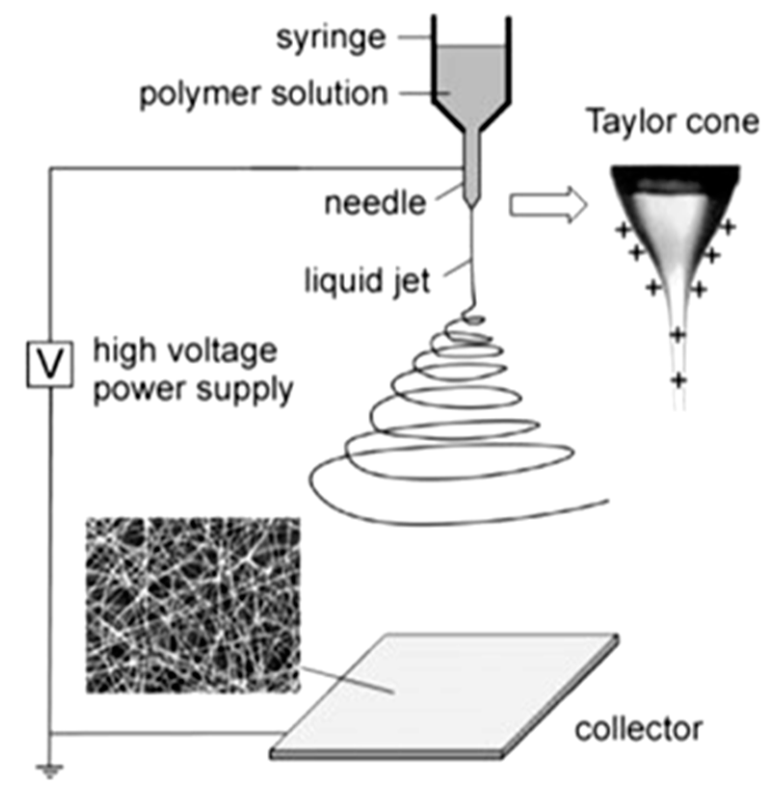
Nanofibers
Nanofibers are extremely thin fibers with diameters in the nanometer range (typically between 1 nm to 1 μm). They can be made from a variety of materials, including polymers, metals, ceramics, and composites. Nanofibers can be produced using a variety of methods, including electrospinning, melt-blowing, phase separation, template synthesis, and self-assembly. Among these methods, electrospinning is the most commonly used technique for the production of polymer nanofibers.

Slide 43
Properties
1. High surface area-to-volume ratio: Nanofibers have a high surface area-to-volume ratio due to their small size and high aspect ratio. This property makes them attractive for applications that require high surface area, such as catalysis, sensors, and tissue engineering.
2. High porosity: Nanofibers can have a high porosity due to the small size of their pores. This property makes them attractive for applications that require high permeability, such as filtration, drug delivery, and tissue engineering.
3. Small pore size: Nanofibers can have a small pore size due to their small diameter. This property makes them attractive for applications that require high selectivity, such as filtration and sensors.
4. High mechanical strength: Nanofibers can have high mechanical strength due to their high aspect ratio and crystallinity. This property makes them attractive for applications that require high strength, such as tissue engineering and structural composites.
5. Flexibility: Nanofibers can be flexible and bendable due to their small size and high aspect ratio. This property makes them attractive for applications that require flexibility, such as wearable electronics and smart textiles.
6. Optical properties: Nanofibers can exhibit unique optical properties, such as strong light scattering and fluorescence, due to their small size and surface chemistry. This property makes them attractive for applications in optics and photonics.

Slide 44
Applications
1. Tissue engineering: Nanofibers can be used as scaffolds to guide the growth of cells and tissues. The high surface area and porosity of nanofibers make them attractive for tissue engineering applications, such as bone, cartilage, and nerve regeneration.
2. Drug delivery: Nanofibers can be used to encapsulate drugs and control their release rate. The high surface area and porosity of nanofibers allow for high drug loading and efficient drug release, making them attractive for drug delivery applications.
3. Filtration: Nanofibers can be used to create highly efficient filters for air and water purification. The small pore size and high porosity of nanofibers allow for high filtration efficiency and low pressure drop.
4. Energy storage: Nanofibers can be used as electrodes in energy storage devices, such as batteries and supercapacitors. The high surface area and mechanical strength of nanofibers allow for high energy and power density.
5. Sensors: Nanofibers can be used to create highly sensitive and selective sensors for various analytes. The small pore size and high surface area of nanofibers allow for high sensitivity and selectivity.
6. Textiles: Nanofibers can be used to create smart textiles with various functionalities, such as sensing, actuation, and energy storage. The flexibility and high aspect ratio of nanofibers allow for seamless integration into textiles.

Slide 45
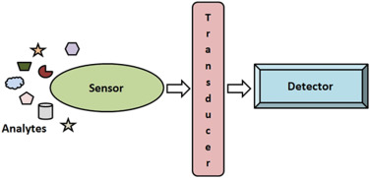
Nanosensors
Nanosensors are devices designed to detect and respond to physical, chemical, biological, or environmental stimuli at the nanoscale level. They typically consist of nanomaterials or nanostructures that exhibit specific properties allowing them to detect and interact with target substances or signals. These sensors are used in various fields and applications due to their high sensitivity, small size, and ability to provide real-time monitoring and detection.

Slide 46
Based on Working Principle:
Optical Nanosensors: These sensors utilize changes in light properties (absorption, emission, reflectance, or scattering) caused by interactions with the target analyte to detect and quantify substances. Examples include fluorescence-based sensors using quantum dots or plasmonic nanoparticles.
Electrochemical Nanosensors: They measure changes in electrical properties (such as current, voltage, impedance) resulting from the electrochemical reactions between the sensing surface and the analyte. Carbon nanotubes, graphene, or metal nanoparticles can be used in electrochemical sensors.
Mechanical Nanosensors: These sensors detect mechanical changes or forces, such as strain, pressure, or mass changes, to infer the presence or quantity of a substance. Nanowires, nanomechanical resonators are commonly employed in mechanical sensors.
Magnetic Nanosensors: They rely on changes in magnetic properties induced by the presence of the analyte. Magnetic nanoparticles or nanocomposites are often used in these sensors.

Slide 47
Properties of Nanosensors
High Sensitivity: Nanosensors can detect very small quantities of analytes due to their high surface-to-volume ratio, enabling the recognition of low concentrations of substances.
Fast Response Time: The small size and rapid interaction of nanomaterials with target analytes contribute to quick response times, allowing real-time or near real-time monitoring and detection.
Miniaturization: Nanosensors can be incredibly small in size, facilitating integration into miniaturized devices and enabling their use in compact systems or even wearable technologies.
Multiplexing Capability: Some nanosensors can detect multiple analytes simultaneously, enabling multiplexed sensing for various substances in a single measurement.
Low Power Consumption: Certain nanosensors have low power requirements, making them suitable for applications requiring minimal energy consumption or for integration into portable or battery-operated devices.
Adaptability to Various Environments: Nanosensors can be engineered to operate in diverse environments, including liquid, gas, biological, or harsh industrial settings, expanding their applicability across different industries and fields.

Slide 48
Applications of Nanosensors
Diagnostics and Disease Monitoring: Nanosensors are used for early detection of diseases by identifying biomarkers in bodily fluids, aiding in the diagnosis of conditions like cancer, diabetes, and cardiovascular diseases.
Drug Delivery Systems: They play a role in targeted drug delivery, ensuring precise and controlled release of medications to specific cells or tissues while minimizing side effects.
Health Monitoring and Wearable Devices: Nanosensors integrated into wearable devices enable continuous monitoring of vital signs, glucose levels, and other health parameters, facilitating personalized healthcare.
Detection of Hazardous Substances: They assist in identifying and monitoring hazardous chemicals, gases, and environmental pollutants, contributing to environmental safety and pollution control.
Food Safety and Quality Control: Nanosensors help in detecting pathogens, contaminants, and spoilage indicators in food products, ensuring food safety and maintaining quality throughout the production and supply chain.
Explosives and Chemical Agent Detection: Nanosensors are employed in detecting explosives, chemical, and biological threats, aiding in security and defense applications.

Slide 49

Nanophotonics
Nanophotonics is a field of science and technology that focuses on the manipulation, control, and application of light on the nanometer scale. It combines principles of photonics (the study of light generation, detection, and manipulation) with nanotechnology (dealing with materials and structures at the nanoscale, typically below 100 nanometers).

Slide 50
Properties of nanophotonic materials
Size-Dependent Optical Properties: At the nanoscale, materials interact with light differently compared to their bulk counterparts. Their optical properties such as absorption, emission, scattering, and refraction can be tuned and controlled by manipulating their size, shape, and composition.
Enhanced Light-Matter Interaction: Nanostructures can confine and manipulate light on a scale smaller than the wavelength of light, leading to phenomena like enhanced light-matter interactions, strong light confinement, and increased local electromagnetic fields.
Tunable Optical Response: Nanophotonic materials often exhibit tunability in their optical response. By altering their dimensions, composition, or surrounding environment, their optical properties can be adjusted, offering flexibility in designing devices with desired functionalities.
Surface Plasmon Resonance: Some nanomaterials, like metallic nanoparticles, exhibit surface plasmon resonance (SPR), allowing for highly sensitive detection, enhanced light absorption, and manipulation of electromagnetic fields at the nanoscale.
Photonic Bandgap Effects: Nanostructured materials, such as photonic crystals, can control the propagation of light by creating bandgaps where certain wavelengths are forbidden, enabling the manipulation of light transmission and reflection.
Flexible and Lightweight: Some nanophotonic materials can be fabricated as thin films or flexible structures, enabling their integration into flexible or wearable devices for photonics, sensing, and energy applications.

Slide 51
Applications of nanophotonics
Optical Computing: Utilizing nanophotonic components for faster, more energy-efficient optical computing systems that process information using photons instead of electrons, potentially leading to higher processing speeds and reduced power consumption.
High-Speed Communications: Development of high-speed data transmission technologies using nanophotonics, enhancing data transfer rates and bandwidth in telecommunications, optical interconnects, and data centers.
Photonic Integrated Circuits: Nanophotonic components integrated on a chip scale enable the development of photonic integrated circuits (PICs). These circuits can process, manipulate, and transmit light signals, potentially revolutionizing information processing and communication technologies.
Photovoltaics and Solar Energy: Nanostructured materials enhance light absorption and efficiency in solar cells, leading to improved photovoltaic performance and the development of more efficient solar energy conversion technologies.
Biomedical Applications: Nanophotonics plays a role in various biomedical applications, including targeted drug delivery, bioimaging, photothermal therapy, and biosensing, due to its ability to interact with biological molecules and tissues at the nanoscale.
Environmental Remediation: Nanophotonic materials are used in environmental applications, such as water purification and pollutant detection, by facilitating efficient light-driven processes for degradation and sensing of pollutants.

Slide 52
Light-emitting electrochemical cell (LEC)
A light-emitting electrochemical cell (LEC) is a type of device that generates light using electrochemical processes. It consists of a layer of light-emitting material sandwiched between two electrodes, which are immersed in an electrolyte solution. The electrodes are typically made of a metal or a conducting polymer, while the light-emitting layer is usually an organic semiconductor material.

Slide 53
The working principle of LECs involves the following steps:
• When a voltage is applied to the electrodes, electrons are injected into the light-emitting layer from the cathode, while holes are injected from the anode.
• The injected electrons and holes can form excitons (electron-hole pairs) in the light-emitting layer.
• The excitons can decay radiatively, releasing energy in the form of light.
• The electrochemical processes in the device result in the regeneration of the initial charged species, which can be used again to generate light.

Slide 54
Properties
Light-emitting electrochemical cells (LECs) have several unique properties that make them attractive for a wide range of applications.
• Low-cost fabrication: LECs can be fabricated using simple and low-cost methods, such as spin-coating, inkjet printing, or screen printing, which can lead to significant cost savings compared to other light-emitting devices.
• High efficiency: LECs can exhibit high internal quantum efficiency. This high efficiency can lead to brighter and more energy-efficient light sources.
• Flexibility: LECs can be fabricated on flexible substrates, allowing for the development of flexible and conformal light sources that can be integrated into a wide range of applications.
• Large-area coverage: LECs can be fabricated over large areas, making them suitable for the development of large-scale lighting and display applications.
• Low-voltage operation: LECs can operate at low voltages, typically below 5V, which can reduce power consumption and extend the lifetime of the device.
• Tunable emission properties: The emission properties of LECs can be tuned by varying the composition and thickness of the light-emitting layer, allowing for the development of devices with different colors and spectral properties.

Slide 55
Applications
Light-emitting electrochemical cells (LECs) have a wide range of potential applications due to their low cost, simplicity, and flexibility.
• Lighting: LECs can be used to produce bright and energy-efficient lighting sources, with the potential to replace traditional incandescent or fluorescent bulbs.
• Displays: LECs can be used to create flexible and lightweight displays, including large-area displays for signage and advertising, as well as small-scale displays for wearable electronics and mobile devices.
• Sensors: LECs can be used as sensors for detecting gases, biological molecules, and other analytes.
• Photovoltaics: LECs can be used to produce electricity from sunlight, by combining a light-absorbing layer with a light-emitting layer.
• Medical applications: LECs can be used in medical applications, such as in wearable devices that monitor vital signs, as well as in implantable devices that require low-power and long-lasting light.

